Slide 1
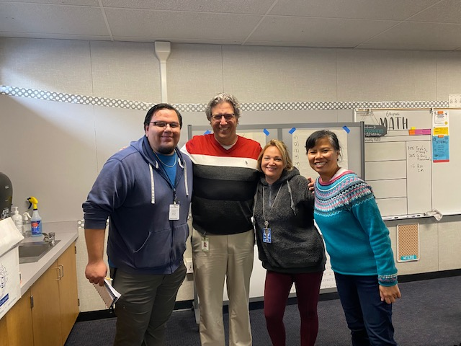
Co-Teachings Top Teacher Moves MVUSD, March 2023
Service and Commitment to Every Student, Every Day, Without Predictions

Slide 2
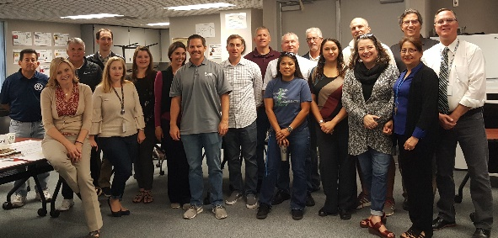
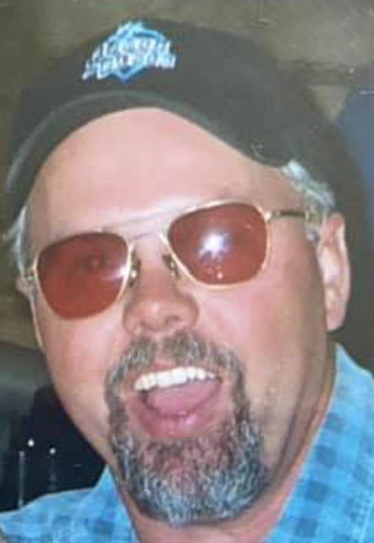
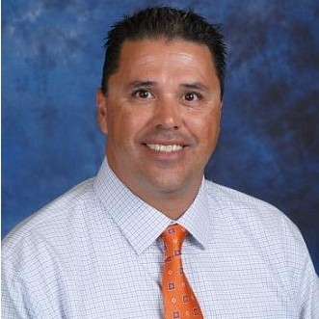
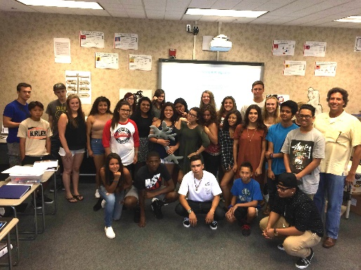
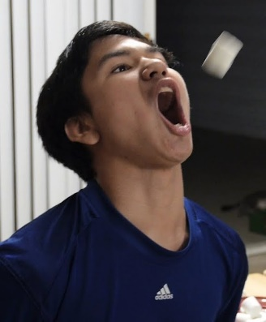
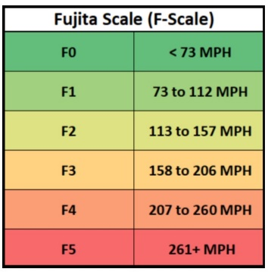
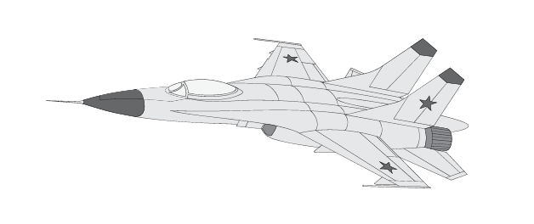
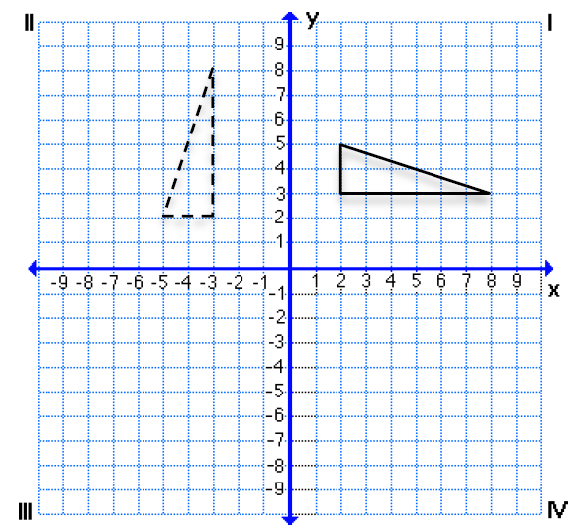
My Journey
Chris Shore

Slide 3
Top Teacher Moves Our Objectives Today
Share Success & Professional Learning.
Model use of Data & Goals.
Show the Top Teacher Moves.
Discuss Co-Teachers’ Big Take-Aways.
Open-Up Dialogue.
You Change the World, One Lesson at a Time.

Slide 4
Warm-Springs Math 6 Co-Taught Students
Current Reality
Math 6 Cored w/ Science 36% SpEd/EL
64% SED
22% Passed State Test G5
25% Untested
Year-End Goal
51% Passed State Test G6
100% Untested

Slide 5
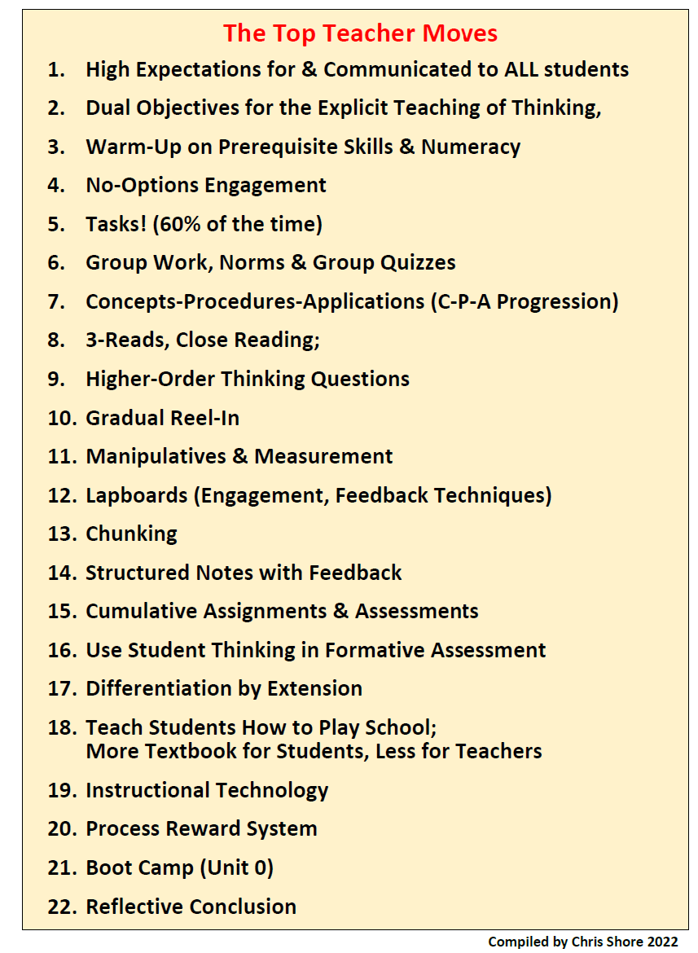
Top Teacher Moves
22 Low-Investment, High-Yield Strategies
Which do you already use?
For which do you have questions?
Notes:
10:00

Slide 6
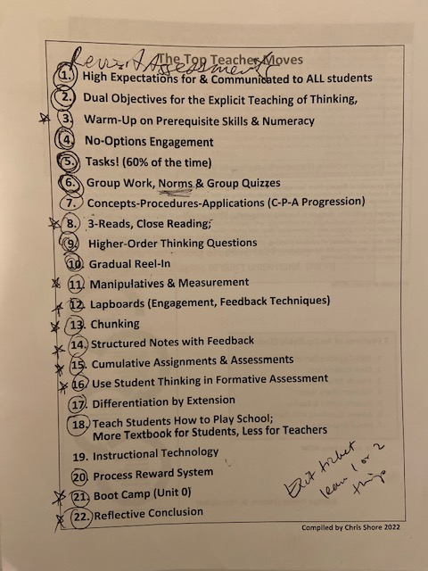
Mary’s Learning

Slide 7
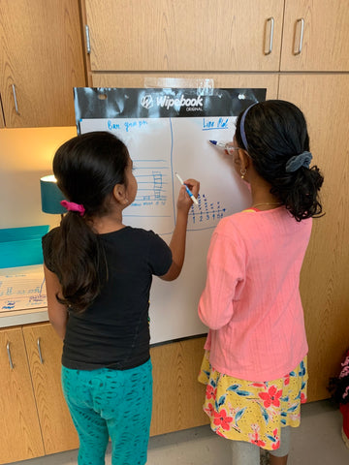
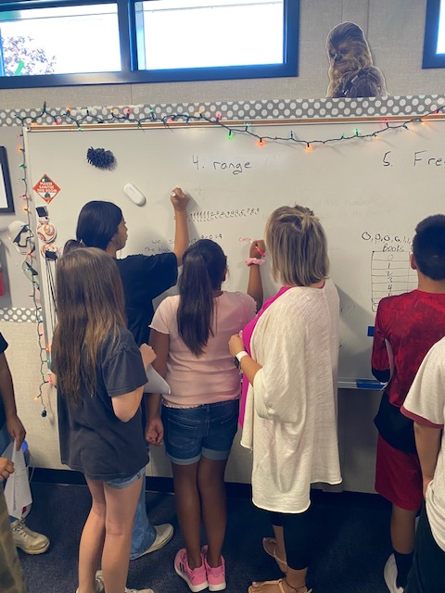
Co-Teaching Model
GenEd Teacher (One Teach)
First Instruction
No-Options (Tier II Intervention)
SpEd Teacher (One Assist)
Assessment Accommodations
Student Assistance
No-Options (Tier I & II Intervention)

Slide 8
Intervention
Wednesdays
9:00 PRIDE (15 min)
1:00 Office Hours*
2:00 Team Course Meetings
*Play Option: All Assignments, Passing All Classes = Blacktop, Gym, or Tutorial
*Work Option: Missing Assignments, D/F = In Teacher’s Classroom

Slide 9
1st Semester Successes
Sem 1 Grades
A | 15 | 25%
B | 10 | 16%
C | 25 | 41%
D | 10 | 16%
F | 1 | 2%
Total | 61 | 2.46
Mark 4 Grades
A | 27 | 43%
B | 28 | 44%
C | 8 | 13%
D | 0 | 0%
F | 0 | 0%
Total | 63 | 3.3
Make this the mode; move 15 C’s
Cut D/F’s in Half
41%
Work Completion
61%
No Discipline Problems

Slide 10
1st Semester Successes
Final Exam Averages
Class 75%
Dept 75%
GenEd 85%
SpEd 65%
(53%)
(52%)

Slide 11
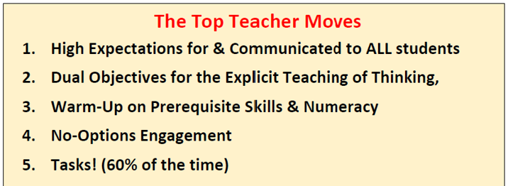
The Top 5

Slide 12
Root Causes
What are the top two reasons that students fail?
They don’t do their work.
&
They don’t have the prerequisite skills for the course.

Slide 13
No-Options Engagement
≈100%
What percentage of your D/F’s do you think are from students having the option of not doing their very best.

Slide 14
Be the Warm Demander

Slide 15
Prerequisite Skills
When & Where?
Prerequisite Warm-Ups
Cumulative Homework & Assessments
Number Sense Activities
Pretests & Intervention on Prereqs

Slide 16
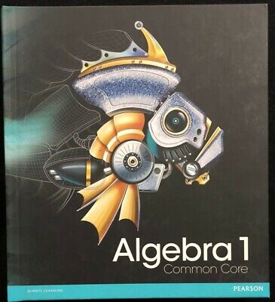
Top Teacher Moves
Rigor, Rigor & More Rigor
Notes:
11:30

Slide 17
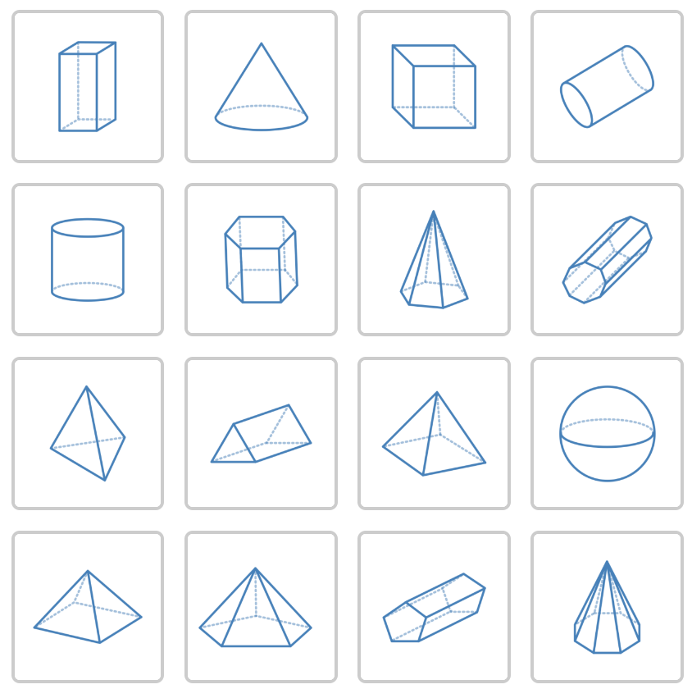
Mary’s Top Successes
Objective: I will model my world with 1-step equations.
Success Criteria: I will model 6 hopping scenarios with 1-step equations and use them to determine the length of the hops.
Clotheslines Math
Math Practice Wordles
4-Digit Problem
Exponential Alice
Truffles
Hippity-Hoppity
Don’t Break My Stride
Desmos, Desmos, Desmos

Slide 18
Top Teacher Moves Our Objectives Today
Share Success & Professional Learning.
Model use of Data & Goals.
Show the Top Teacher Moves.
Discuss Co-Teachers Big Take-Aways.
Open-Up Dialogue.
You Change the World, One Lesson at a Time.

